Slide 1

EVEREST ENGINEERING COLLEGE Sanepa, Lalitpur
A
Final report Presentation on
“PREDICTION OF A COMPANY'S STOCK PRICE USING MACHINE LEARNING”
Project Members:
NABIN KUMAR BAMMA
RABIN KUMAR MANDEL
SANTOSH CHAPAGAIN
Susil kumar Shrestha

Slide 2
CONTENTS
Title
Introduction
Aim and Objective
Application
Project Feature
Literature review
Methodology
Variables
Model Used
System Design
Result and Analysis
Limitation
Conclusion
References

Slide 3
INTRODUCTION
Stock market prediction
Place where a company’s shares are traded.
Forecasting the current trends of a company and predict the value of stocks whether it’s going up or down.
Helps you discover the future value of company stock .
Idea of predicting stock prices to gain significant profits.
Factors involved in predication.

Slide 4
AIM AND OBJECTIVE
To propose and design an efficient model to predict the trend in the stock market price.
To analyze, forecast and compare the three different models based on the metrics like MAE and RMSE.

Slide 5
APPLICATION
Can be applicable to discover the future value of company stock traded on the exchange.

Slide 6
PROJECT FEATURE
Predict stock price using daily data.
Gives graph chart of the predicted and the original data.

Slide 7
LITERATURE REVIEW-1
Stock Market Prediction Using Machine Learning
In this research work [3], the Yahoo finance stock data is predicted.
ML approach that trained from the available stocks data and
Gain intelligence and then uses the acquired knowledge for an accurate prediction
Forecasting the Stock Market Index Using Artificial Intelligence Techniques
In this paper [4], forecasting the future price of an asset based on the information contained in the historical prices of an asset.
We used the three different model
LSTM, SVR and Random Forest
Predicting stock price from past closing prices of the individual stock.

Slide 8
LITERATURE REVIEW-2
Stock Price Correlation coefficient prediction with ARIMA –LSTM Hybrid Model.
In this research paper [6] predicting the price correlation of two assets for future time periods is important in portfolio optimization.
Technology industry on financial ratios and both factor [7].
Lots of studies related to the effect of internal factors and external factors on stock.
Thim et al, investigated the factors affecting the performance of many property firms listed method has been applied to represent all the variables comprising stock.
Some are performance, return on equity, debt ratio, and EPS, and PE, inflation, industrial production, exchange rate and interest rate.

Slide 9
METHODOLOGY
Is a development system of methods
That is used to plan, structure, and control the process of developing an information system.

Slide 10
VARIABLES
Date
Open
Close
High
Low
EPS
P/E
Inflation Rate
Interest Rate
Adj close
Volume

Slide 11
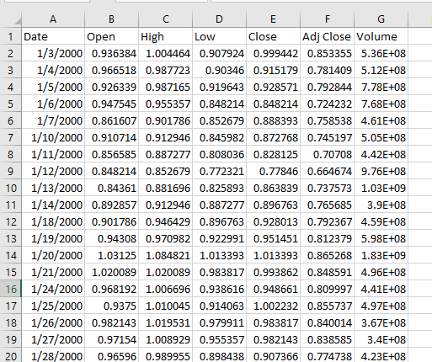
SAMPLE DATASET

Slide 12
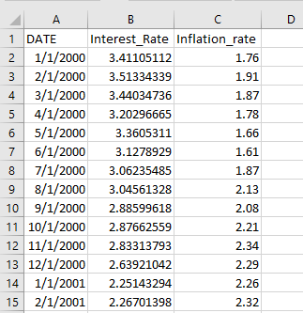
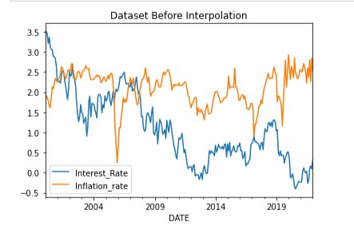
DATA BEFORE INTERPOLATION

Slide 13
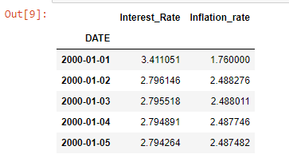
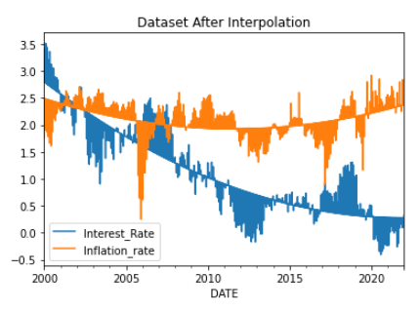
DATA AFTER INTERPOLATION

Slide 14
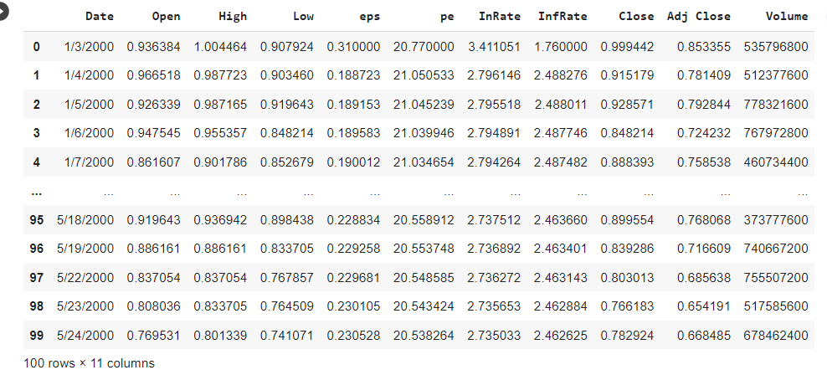
FINAL DATASET

Slide 15
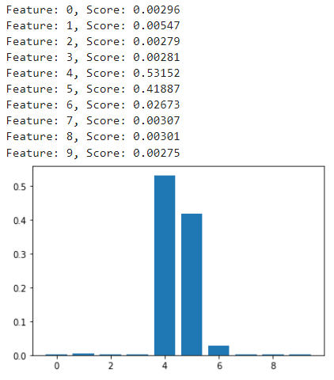
FEATURE SELECTION OF VARIABLE

Slide 16
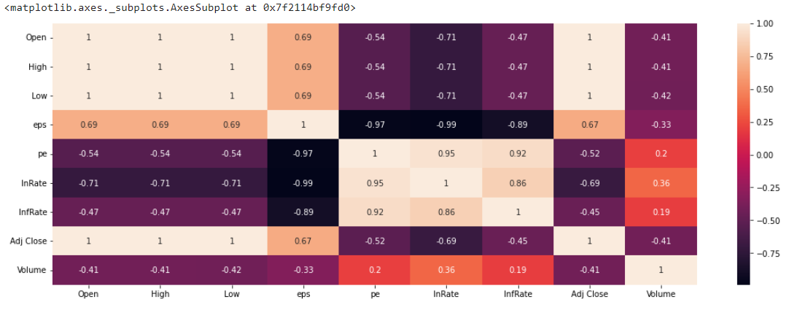
CORRELATION MATRIX

Slide 17
MODEL USED
Long Short-Term Memory (LSTM)
Random Forest Regression
Support Vector Regression

Slide 18
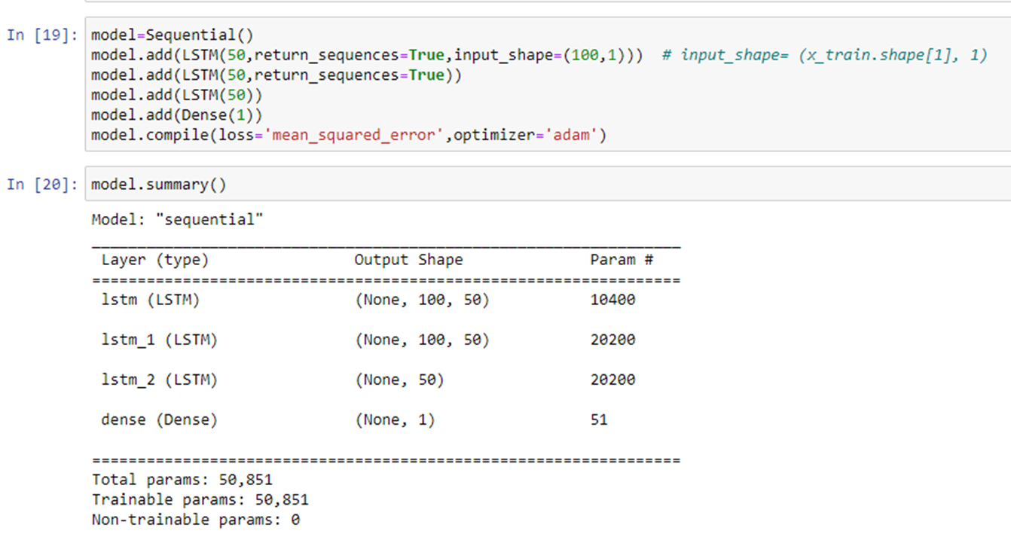

Long Short-Term Memory (LSTM)
Long Short- Term Memory (LSTM) is a modified version of recurrent neural networks, which makes it easier to remember past data in memory.

Slide 19
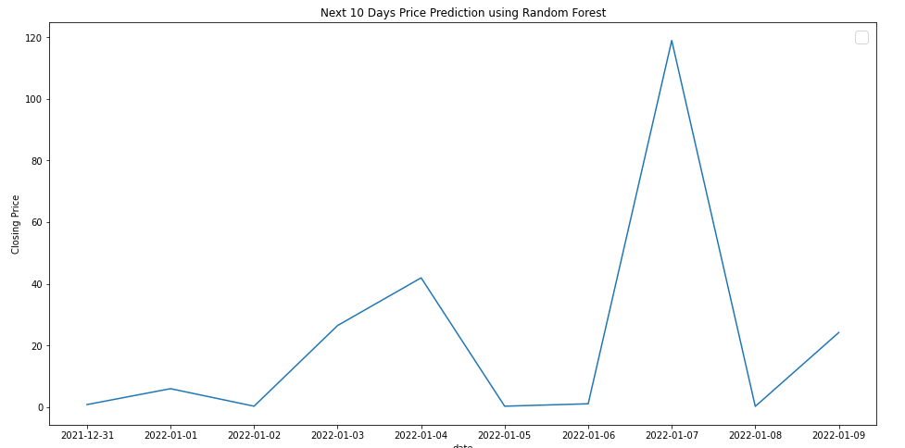
RANDOM FOREST REGRESSOR
Based on decision trees that resolves the problem of over fitting existing in simple decision tree models by bagging on training data and variables.

Slide 20
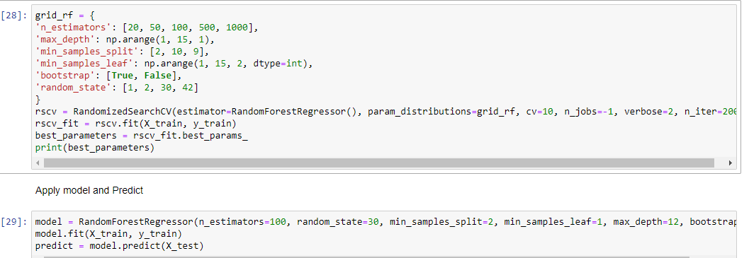

Hyperparameter tuning of the Random Forest Regressor

Slide 21
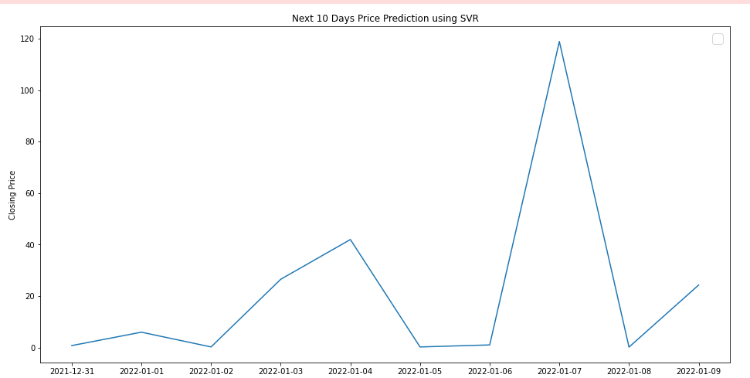
SUPPORT VECTOR REGRESSION
SVR is regression technique to minimize error using most suitable hyper plane. Different kernel functions such as linear, RBF, Sigmoid and Polynomial are used and selecting kernel function is significant for regression.

Slide 22
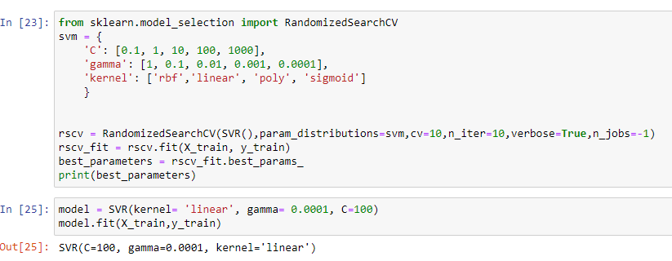
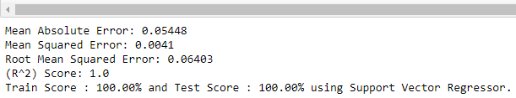
Hyperparameter tuning and performance metrics of the Support Vector Regressor

Slide 23
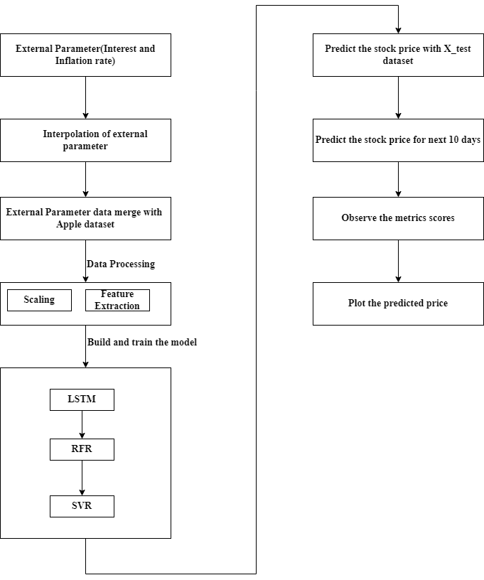
SYSTEM DESIGN DIAGRAM

Slide 24
RESULTS AND ANALYSIS
After carefully tuning each individual model’s parameters and preprocessing options,
we report the results obtained from each model.
We take LSTM model as a baseline model,
Random forest model and SVR Model gives less root mean squared error and MAE than LSTM model.
Among the three models Random forest model gives best performance.

Slide 25
Compare Performance of three different predictions models
Model | Tuning parameters | MAE | RMSE
LSTM Model | 2 LSTM layer, 50 nodes each, Dropout 0.2, batch size 64, epochs 100. | 81.37418 | 90.12949
Support Vector Regressor | C=100, Gamma=0.0001, Kernel=Linear | 0.05448 | 0.06403
Random Forest Regressor | n_estimators=100, random state=30, min_sample_split=2, min_samples_leaf=1, max_depth=12, bootstrap=True) | 0.03127 | 0.11723

Slide 26
LIMITATIONS
Although there are many internal and external factors, we selected a small number of parameters to predict the stock price. As a result, LSTM has higher error.

Slide 27
CONCLUSION
Stock price forecasting is challenging due to noisy, dynamic, and nonlinear data in the stock market.
We proposed three different models.
For the upcoming ten days, our project will forecast the stock's closing price.

Slide 28
REFERENCES
[1] Y. E. Cakra and B. Distiawan Trisedya, "Stock price prediction using linear regression based on sentiment analysis," 2015 International Conference on Advanced Computer Science and Information Systems (ICACSIS), 2015, pp. 147- 154
[2] Kumar, Manish, and M. Thenmozhi. (2006) “Forecasting stock index movement: A comparison of support vector machines and random forest”In Indian institute of capital markets 9th capital markets conference paper
[3] Selvin, Sreelekshmy, R. Vinayakumar, E. A. Gopalakrishnan, Vijay Krishna Menon, and K. P. Soman. (2017) “Stock price prediction using LSTM, RNN and CNN-sliding window mode.” International Conference on Advances in Computing, Communications and Informatics(ICACCI): 1643-1647.
[4]Y. Zhu, “Stock price prediction using the RNN model,” J. Phys. Conf. Ser., vol

Slide 29

QNA SECTION

